Slide 1
Human Interface Devices (HID)
DANIELE MAZZEI

Slide 2
Human Interface Devices
A human interface device or HID is a type of computer device usually used by humans.
HID takes input from humans and gives output to humans.
The term "HID" is used to indicate the physical devices and also the USB-HID specification.
The term was coined by Mike Van Flandern of Microsoft when he proposed that the USB committee create a Human Input Device class working group. The working group was renamed as the Human Interface Device class at the suggestion of Tom Schmidt of DEC because the proposed standard supported bi-directional communication.

Slide 3
HID software specification

Slide 4
HID (software specification)
The HID standard was adopted primarily to enable innovation in PC input devices and to simplify the process of installing such devices.
Prior to the introduction of the HID concept, devices usually conformed to strictly defined protocols for mouse, keyboards and joysticks; for example, the standard mouse protocol at the time supported relative X- and Y-axis data and binary input for up to two buttons, with no legacy support.
All hardware innovations necessitated either overloading the use of data in an existing protocol or the creation of custom device drivers and the evangelization of a new protocol to developers. By contrast, all HID-defined devices deliver self-describing packages that may contain any number of data types and formats.

Slide 5
HID (software specification)
A single HID driver on a computer parses data and enables dynamic association of data I/O with application functionality, which has enabled rapid innovation and development, and prolific diversification of new human-interface devices.
The HID protocol has its limitations, but all modern mainstream operating systems will recognize standard USB HID devices, such as keyboards and mice, without needing a specialized driver. When installed, a message saying that "A 'HID-compliant device' has been recognized" generally appears on screen.
In comparison, this message does not usually appear for devices connected via the PS/2 6-pin DIN connectors which preceded USB. the PS/2 standard does not support the HID protocol.
The USB human interface device class describes a USB HID.

Slide 6
HID (software specification)
In the HID protocol, there are 2 entities: the "host" and the "device".
The device is the entity that directly interacts with a human, such as a keyboard or mouse.
The host communicates with the device and receives input data from the device on actions performed by the human. Output data flows from the host to the device and then to the human.

Slide 7
HID (software specification)
The HID protocol makes implementation of devices very simple.
Devices define their data packets and then present a "HID descriptor" to the host.
The HID descriptor is a hard coded array of bytes that describes the device's data packets.
This includes:
how many packets the device supports,
the size of the packets,
the purpose of each byte and bit in the packet.
For example, a keyboard with a calculator program button can tell the host that the button's pressed/released state is stored as the 2nd bit in the 6th byte in data packet number 4

Slide 8
HID (software specification)
The device typically stores the HID descriptor in ROM and does not need to intrinsically understand or parse the HID descriptor. Some mouse and keyboard hardware in the market today is implemented using only an 8-bit CPU.
The host is expected to be a more complex entity than the device. The host needs to retrieve the HID descriptor from the device and parse it before it can fully communicate with the device.
Parsing the HID descriptor can be complicated. Multiple operating systems are known to have shipped bugs in the device drivers responsible for parsing the HID descriptors years after the device drivers were originally released to the public.
However, this complexity is the reason why rapid innovation with HID devices is possible.

Slide 9
HID (software specification)
The above mechanism describes what is known as HID "report protocol".
Because it was understood that not all hosts would be capable of parsing HID descriptors, HID also defines "boot protocol". In boot protocol, only specific devices are supported with only specific features because fixed data packet formats are used.
The HID descriptor is not used in this mode so innovation is limited.
However, the benefit is that minimal functionality is still possible on hosts that otherwise would be unable to support HID.
The only devices supported in boot protocol are: Keyboard and Mouse
https://makeymakey.com/

Slide 10
Other protocols using HID
Since HID's original definition over USB, HID is now also used in other computer communication buses.
This enables HID devices that traditionally were only found on USB to also be used on alternative buses. This is done since existing support for USB HID devices can typically be adapted much faster than having to invent an entirely new protocol to support mouse, keyboards, and the like.
Known buses that use HID are:
Bluetooth HID – Used for mouse and keyboards that are connected via Bluetooth
Serial HID – Used in Microsoft's Windows Media Center PC remote control receivers.
ZigBee input device – ZigBee (RF4CE) supports HID devices through the ZigBee input device profile.
HID over I²C – Used for embedded devices in Microsoft Windows 8[2]
HOGP (HID over GATT) – Used for HID devices connected using Bluetooth low energy technology

Slide 11
HID Devices

Slide 12
HID (peripheral)
HID peripherals can be organized in two main categories:
Input devices
Output devices
Input devices are based on sensors (a device, module, or subsystem whose purpose is to detect events or changes in the physical world its environment and convert it in analog or digital electronic information)
Output devices are based on actuators (a device, module, or subsystem whose purpose is to convert analog or digital electronic signals in physical events aimed at changing the physical)

Slide 13
HID classification (old fashion)
Input or Output HID are typically divided in classes according to the type of input/output used by the HID:
Texts and chars
Positions
Sound
Images
Environmental parameters
Position
Health/bio/physiological parameters
Nowadays most of the novel HIDs use mixed technology so it is difficult to still classify them on the basis of what they sense...

Slide 14
Input Devices

Slide 15
Keyboards
The most used text and chars HID is the keyboard
Different types of keyboards are available and each is designed with a focus on specific features that suit particular needs. Today, most full-size keyboards use one of three different mechanical layouts, usually referred to as simply ISO (ISO/IEC 9995-2) ANSI standard.
ANSI standard alphanumeric keyboards have keys that are on three-quarter inch centers (0.75 inches (19 mm)), and have a key travel of at least 0.15 inches (3.8 mm).
Modern keyboard models contain a set number of total keys according to their given standard, described as 101, 104, 105, etc. and sold as "Full-size" keyboards.

Slide 16
Keyboard layouts
A keyboard layout is any specific physical, visual or functional arrangement of the keys, legends, or key-meaning associations (respectively) of a computer keyboard, mobile phone, or other computer-controlled typographic keyboard.
Physical layout is the actual positioning of keys on a keyboard.
Visual layout the arrangement of the legends (labels, markings, engravings) that appear on those keys.
Functional layout is the arrangement of the key-meaning association or keyboard mapping, determined in software, of all the keys of a keyboard: this (rather than the legends) determines the actual response to a key press.

Slide 17
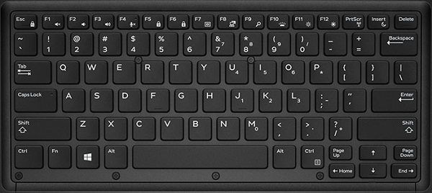

Slide 18
Keyboard layouts
Modern computer keyboards are designed to send a scancode to the operating system (OS) when a key is pressed or released: this code reports only the key's row and column, not the specific character engraved on that key.
The OS converts the scancode into a specific binary character code using a "scancode to character" conversion table, called the keyboard mapping table.
This means that a physical keyboard may be dynamically mapped to any layout without switching hardware components – merely by changing the software that interprets the keystrokes.

Slide 19
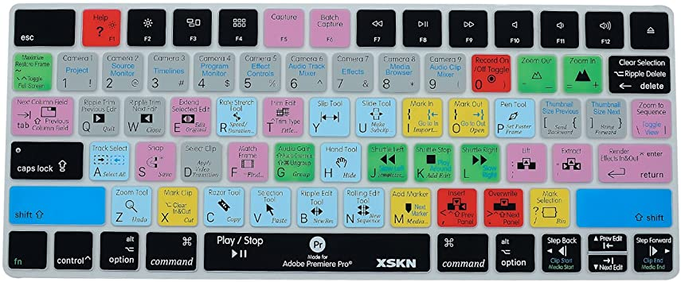

Slide 20
QWERTY Layout
The QWERTY layout far the most widespread layout in use, and the only one that is not confined to a particular geographical area.
QWERTY is a keyboard layout design for Latin-script alphabets.
The name comes from the order of the first six keys on the top left letter row of the keyboard (Q W E R T Y)

Slide 21
Multifunctional keyboards
Provide additional function beyond the standard keyboard.
Many are programmable, configurable computer keyboards and some control multiple PCs, workstations and other information sources, usually in multi-screen work environments.
Users have additional key functions as well as the standard functions and can typically use a single keyboard and mouse to access multiple sources.
Multifunctional keyboards may feature customised keypads, fully programmable function or soft keys for macros/pre-sets, biometric or smart card readers, trackballs, etc.
New generation multifunctional keyboards feature a touchscreen display to stream video, control audio visual media etc.
Common environments for multifunctional keyboards are complex, high-performance workplaces for financial traders and control room operators (emergency services, security, air traffic management; industry, utilities management, etc.).

Slide 22
Barcode readers
A barcode reader (or barcode scanner) is an optical scanner that can read printed barcodes, decode the data contained in the barcode and send the data to a computer.
Like a flatbed scanner, it consists of a light source, a lens and a light sensor translating for optical impulses into electrical signals.
Additionally, nearly all barcode readers contain decoder circuitry that can analyze the barcode's image data provided by the sensor and sending the barcode's content to the scanner's output port.

Slide 23
Barcode Readers
A barcode is a method of representing data in a visual, machine-readable form. Standard, barcodes represent data by varying the widths and spacings of parallel lines. A barcode encodes a string (typically numbers)
A QR is a bidimensional barcode. It uses four standardized encoding modes (numeric, alphanumeric, byte/binary, and kanji) to store data efficiently;

Slide 24
RFID
An RFID tag consists of a tiny radio transponder; a radio receiver and transmitter.
When triggered by an electromagnetic interrogation pulse from a nearby RFID reader device, the tag transmits digital data, usually an identifying inventory number, back to the reader. This number can be used to inventory goods.
There are two types:
Passive tags are powered by energy from the RFID reader's interrogating radio waves.
Active tags are powered by a battery and thus can be read at a greater range from the RFID reader; up to hundreds of meters.
Unlike a barcode, the tag doesn't need to be within the line of sight of the reader, so it may be embedded in the tracked object.

Slide 25
NFC
Near-Field-Communication (NFC) is a set of communication protocols for bidirectional communication between two electronic devices over a distance of 4 cm (1​1⁄2 in) or less.
NFC offers a low-speed connection with simple setup that can be used to bootstrap more-capable wireless connections.
Is it a HID or a communication technology?

Slide 26
Pointing Devices
A pointing device is an input interface that allows a user to input spatial (i.e., continuous and multi-dimensional) data to a computer.
CAD systems and graphical user interfaces (GUI) allow the user to control and provide data to the computer using physical gestures by moving a hand-held mouse or similar device across the surface of the physical desktop and activating switches on the mouse.
Movements of the pointing device are echoed on the screen by movements of the pointer (or cursor) and other visual changes.
Common gestures are point and click and drag and drop.

Slide 27
Pointing Devices
While the most common pointing device by far is the mouse, many more devices have been developed. However, the term "mouse" is commonly used as a metaphor for devices that move the cursor.

Slide 28
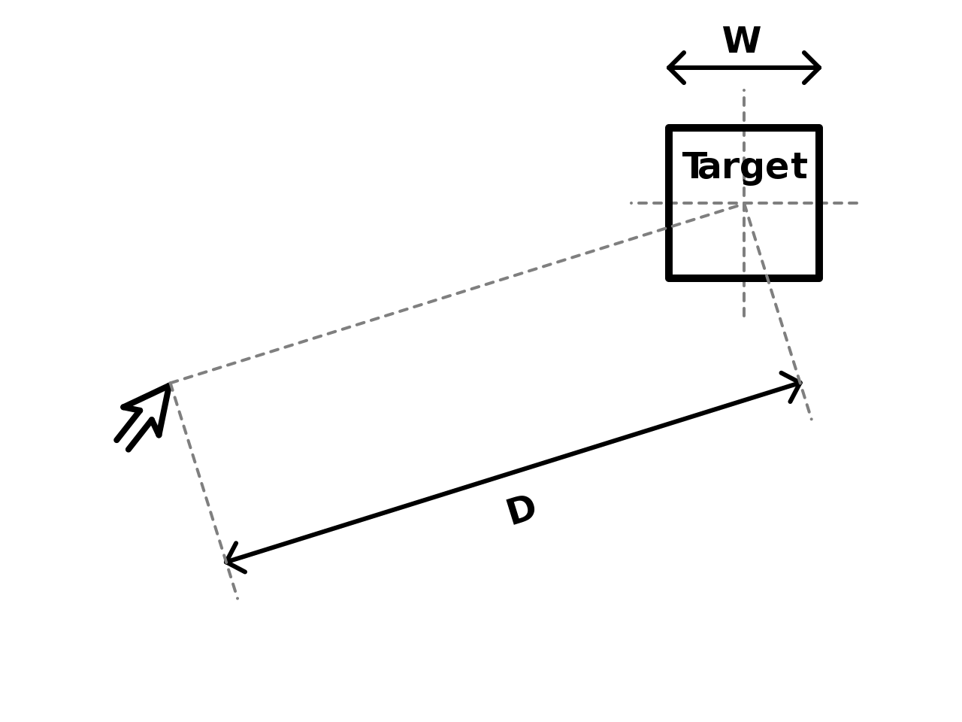
Fitts's law
Fitts's law is a predictive model of human movement primarily used in human–computer interaction and ergonomics.
This scientific law predicts that the time required to rapidly move to a target area is a function of the ratio between the distance (D) to the target and the width of the target (W).
Fitts's law is used to model the act of pointing, either by physically touching an object with a hand or finger, or virtually, by pointing to an object on a computer monitor using a pointing device.

Slide 29

Fitts's law
Movement Time:
a = time to start/stop in seconds (empirically measured per device)
b = inherent speed of the device (empirically measured per device)
D is the distance from the starting point to the center of the target.
W is the width of the target measured along the axis of motion.
Notice that because the ID term depends only on the ratio of distance to width, the model implies that a target distance and width combination can be re-scaled arbitrarily without affecting movement time, which is impossible. Despite its flaws, this form of the model does possess remarkable predictive power across a range of computer interface modalities and motor tasks, and has provided many insights into user interface design principles.

Slide 30
Fitts's law
Proven to provide good timings for most age groups
Newer versions taken into account
Direction (we are faster horizontally than vertically)
Device weight
Target shape
Arm position (resting or midair)
2D and 3D (Zhai ’96)
Zero gravity environment

Slide 31

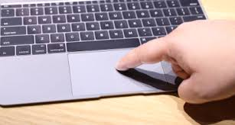
Pointing Devices classification
direct vs. indirect input
In case of a direct-input pointing device, the on-screen pointer is at the same physical position as the pointing device (e.g., finger on a touch screen, stylus on a tablet computer).
An indirect-input pointing device is not at the same physical position as the pointer but translates its movement onto the screen (e.g., computer mouse, joystick, stylus on a graphics tablet).

Slide 32
Pointing Devices classification
absolute vs. relative movement
An absolute-movement input device (e.g., stylus, finger on touch screen) provides a consistent mapping between a point in the input space (location/state of the input device) and a point in the output space (position of pointer on screen).
A relative-movement input device (e.g., mouse, joystick) maps displacement in the input space to displacement in the output state. It therefore controls the relative position of the cursor compared to its initial position.

Slide 33
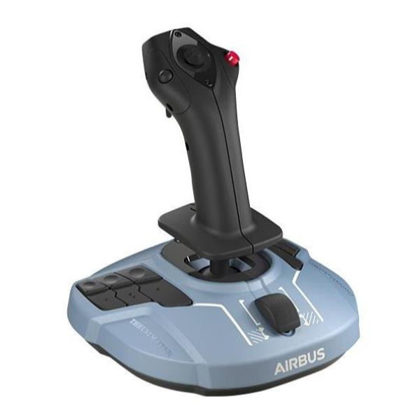

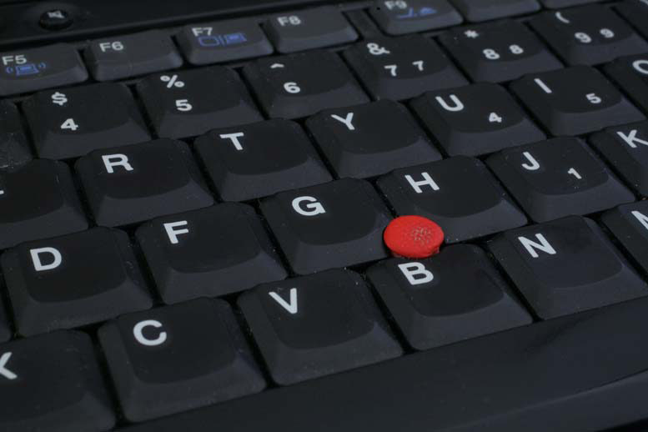
Pointing Devices classification
isotonic vs. elastic vs. isometric
An isotonic pointing device is movable and measures its displacement (mouse, pen, human arm) whereas an isometric device is fixed and measures the force which acts on it (trackpoint, force-sensing touch screen). An elastic device increases its force resistance with displacement (joystick).

Slide 34
Pointing Devices classification
position control vs. rate control
A position-control input device (e.g., mouse, finger on touch screen) directly changes the absolute or relative position of the on-screen pointer. A rate-control input device (e.g., trackpoint, joystick) changes the speed and direction of the movement of the on-screen pointer.

Slide 35
What we know
Direct pointing is Faster but less accurate than indirect (Haller ’84)
Lots of studies confirm mouse is best for most tasks for speed and accuracy: Trackpoint < Trackballs & Touchpads < Mouse
For short distances cursor keys are better than pointing devices
Disabled prefer joysticks and trackballs:
If force application is a problem, then touch sensitive is preferred
Vision impaired have problems with most pointing devices
Use multimodal approach or customizable cursors improve usability and performances
Keep in mind Fits’ law:
Large targets reduce time and frustration;
Designers should smooth out and reduce trajectories

Slide 36
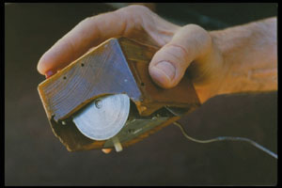
The father of all pointing devices
A computer mouse is a hand-held pointing device that detects two-dimensional motion relative to a surface.
This motion is typically translated into the motion of a pointer on a display, which allows a smooth control of the graphical user interface of a computer.

Slide 37
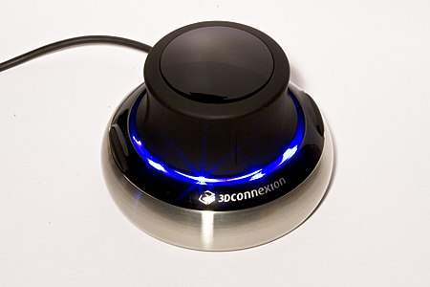
The mouse evolution
In 2000, Logitech introduced a "tactile mouse" that contained a small actuator to make the mouse vibrate. Such a mouse can augment user-interfaces with haptic feedback (output), such as giving feedback when crossing a window boundary.
Other modern pointing devices have extended the input dimensions up to 6 DOF

Slide 38
Novel Pointing Devices

Slide 39
Eye Tracking
Eye tracking is the process of measuring either the point of gaze (where one is looking) or the motion of an eye relative to the head.
An eye tracker is a device for measuring eye positions and eye movement.
Eye trackers are used in research on the visual system, in psychology, in psycholinguistics, marketing, as an input device for human-computer interaction, and in product design.
Eye trackers are also being increasingly used for rehabilitative and assistive applications (related for instance to control of wheel chairs, robotic arms and prostheses).
There are a number of methods for measuring eye movement. The most popular variant uses video images from which the eye position is extracted.

Slide 40
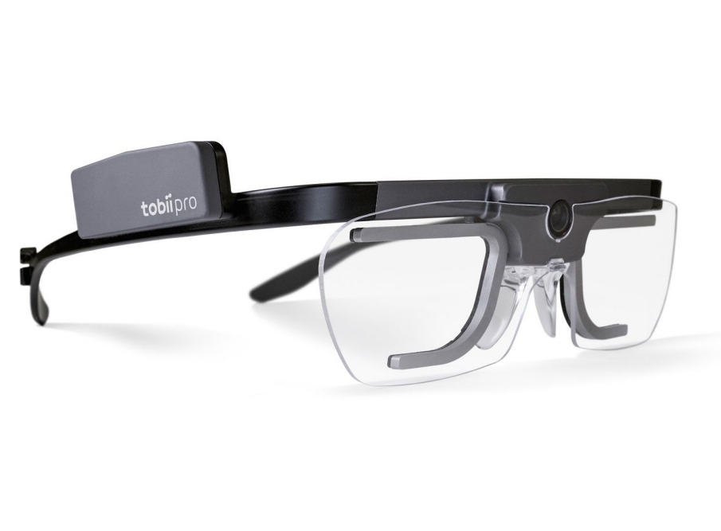

Eye Tracking
Light, typically infrared, is reflected from the eye and sensed by a video camera or some other specially designed optical sensor.
The information is then analyzed to extract eye rotation from changes in reflections.
Video-based eye trackers typically use the corneal reflection and the center of the pupil as features to track over time.

Slide 41
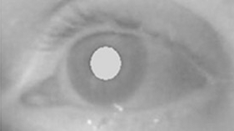
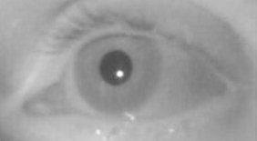
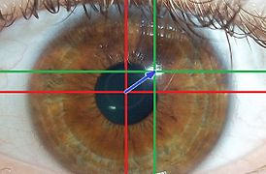
Eye tracking methods
The most widely used current designs are video-based eye-trackers.
A camera focuses on one or both eyes and records eye movement. Most modern eye-trackers use the center of the pupil and infrared/near-infrared non-collimated light to create corneal reflections (CR).
The vector between the pupil center and the corneal reflections can be used to compute the point of regard on surface or the gaze direction. A simple calibration procedure of the individual is usually needed before using the eye tracker.
Two general types of infrared/near-infrared (also known as active light) eye-tracking techniques are used: bright-pupil (top) and dark-pupil (center). Their difference is based on the location of the illumination source with respect to the optics.
Another, less used, method is known as passive light (bottom). It uses visible light to illuminate

Slide 42
Eye tracking methods
If the illumination is coaxial with the optical path, then the eye acts as a retroreflector as the light reflects off the retina creating a bright pupil effect similar to red eye. If the illumination source is offset from the optical path, then the pupil appears dark because the retroreflection from the retina is directed away from the camera.
Bright-pupil tracking creates greater iris/pupil contrast, allowing more robust eye-tracking with all iris pigmentation, and greatly reduces interference caused by eyelashes and other obscuring features. It also allows tracking in lighting conditions ranging from total darkness to very bright.
Bright-pupil tracking is more reliable but require more complex hardware setup

Slide 43
Eye-tracking vs. gaze-tracking
Eye-trackers necessarily measure the rotation of the eye with respect to some frame of reference. This is usually tied to the measuring system. Thus, if the measuring system is head-mounted, as with video-based system mounted to a helmet, then eye-in-head angles are measured.
To deduce the line of sight in world coordinates, the head must be kept in a constant position or its movements must be tracked as well. In these cases, head direction is added to eye-in-head direction to determine gaze direction.
If the measuring system is table-mounted, as with table-mounted camera (“remote”) systems, then gaze angles are measured directly in world coordinates. Typically, in these situations head movements are prohibited.
Some results are available on human eye movements under natural conditions where head movements are allowed as well.

Slide 44
Eye Tracking mouse
https://www.youtube.com/watch?v=oSo8fbZfHLk&ab_channel=TobiiGaming
https://www.youtube.com/watch?v=4fvdBhPdhIU&ab_channel=TobiiPro

Slide 45
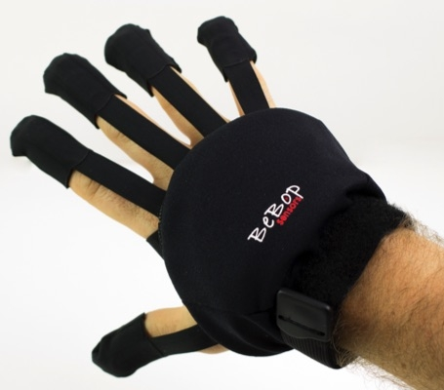
Data Glove
A wired glove (also called a "dataglove") is an input device for human–computer interaction worn like a glove.
Various sensor technologies are used to capture physical data such as bending of fingers.
Often a motion tracker, such as a magnetic tracking device or inertial tracking device, is attached to capture the global position/rotation data of the glove.
These movements are then interpreted by the software that accompanies the glove, so any one movement can mean any number of things.
Gestures can then be categorized into useful information, such as to recognize sign language or other symbolic functions.

Slide 46
Haptic Devices
Haptic devices (or haptic interfaces) are mechanical devices that mediate communication between the user and the computer. Haptic devices allow users to touch, feel and manipulate three-dimensional objects in virtual environments and tele-operated systems.
Most common computer interface devices, such as basic mice and joysticks, are input only devices, meaning that they track a user's physical manipulations but provide no manual feedback. As a result, information flows in only one direction, from the peripheral to the computer.
Haptic devices are input-output devices, meaning that they track a user's physical manipulations (input) and provide realistic touch sensations coordinated with on-screen events (output).

Slide 47
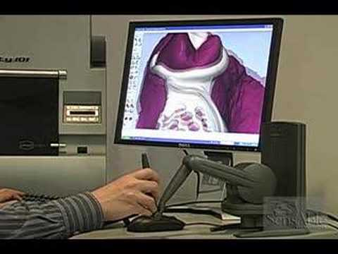
Haptic Devices

Slide 48

Smart Paper, Whiteboards and similars
A novel generation of devices aimed at digitizing user interaction with paper and whiteboard have been developed in the last years.
These devices digitize the user writing by means of tracked smart pens and/or sensorized surfaces
This is a cross categories interface where pointing and images are used as blended inputs

Slide 49
Speech and Auditory Input Interfaces

Slide 50
Audio and sound acquisition
In physics, sound is a vibration that propagates as an acoustic wave, through a transmission medium such as a gas, liquid or solid.
In human physiology and psychology, sound is the reception of such waves and their perception by the brain.
Only acoustic waves that have frequencies lying between about 20 Hz and 20 kHz, the audio frequency range, elicit an auditory percept in humans.
In air at atmospheric pressure, these represent sound waves with wavelengths of 17 meters to 1.7 centimetres.
Sound waves above 20 kHz are known as ultrasound and are not audible to humans. Sound waves below 20 Hz are known as infrasound. Different animal species have varying hearing ranges.

Slide 51
Audio and sound acquisition
Sound can be acquired using microphones.
A microphone is a device – a sensor– that converts sound into an electrical signal.
Microphones are widely used as HID
Several types of microphone are used today, which employ different methods to convert the air pressure variations of a sound wave to an electrical signal.

Slide 52
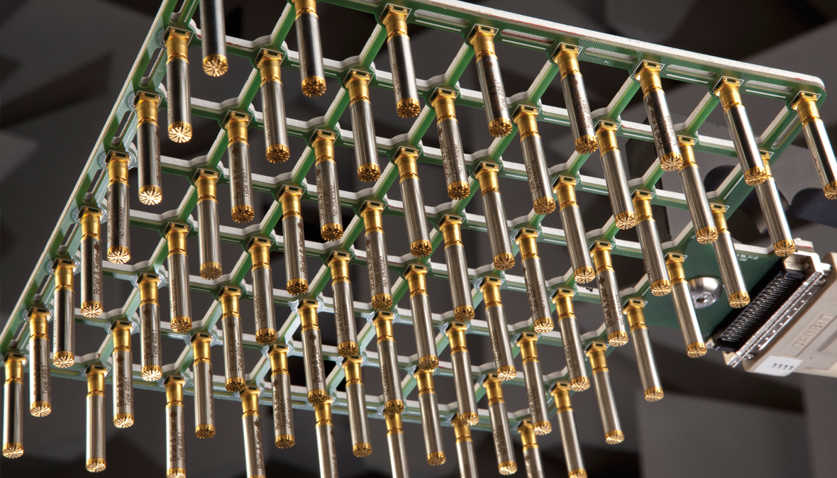
Microphone arrays
A microphone array is any number of microphones operating in tandem.
The are used for:
Systems for extracting voice input from ambient noise (notably telephones, speech recognition systems, hearing aids)
Surround sound and related technologies
Binaural recording
Locating objects by sound: acoustic source localization
High fidelity original recordings
Environmental Noise Monitoring

Slide 53
Microphone Arrays
Typically, an array is made up of omnidirectional microphones, directional microphones, or a mix of omnidirectional and directional microphones distributed about the perimeter of a space
All microphones are linked to a computer that records and interprets the results into a coherent form.
Arrays may also be formed using numbers of very closely spaced microphones.
Given a fixed physical relationship in space between the different individual microphone transducer array elements, simultaneous DSP (digital signal processor) processing of the signals from each of the individual microphone array elements can create one or more "virtual" microphones.

Slide 54
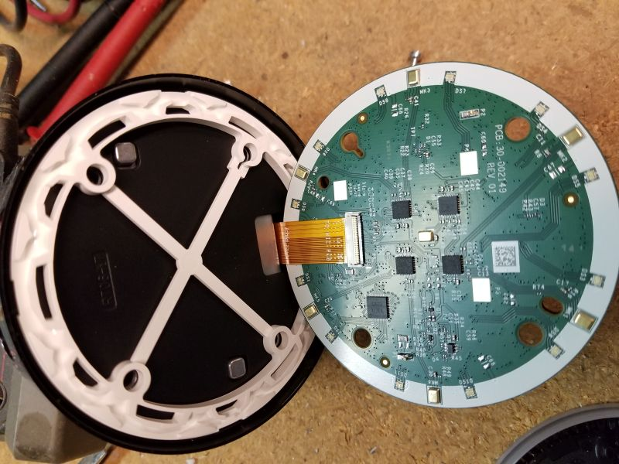


Slide 55
Speech and Auditory Interfaces
There’s the dream…. Then there’s reality
Practical apps don’t really allows freeform discussions with a computer :(
Main Design Goals:
Low cognitive load
Low error rates
Natural user experience

Slide 56
Speech and Auditory Interfaces
Problem and limitations:
Bandwidth is much lower than visual displays
Ephemeral nature of speech (tone, etc.)
Difficulty in parsing/searching → higher computational load
https://www.youtube.com/watch?v=IKZToY-V16w&ab_channel=EliyahuShatz

Slide 57
Speech and Auditory Interfaces
Succeed With:
Specialized vocabularies (like medical or legal)
Dictate reports, notes, letters
Communication skills practice (virtual patient)
Automatic retrieval/transcription of audio content (like radio, CC)
Security/user ID
https://www.youtube.com/watch?v=ZLpuYQ401s8&ab_channel=JonWahrenberger

Slide 58
Image based Input User Interfaces

Slide 59
Image Sensors
An image sensor is a sensor that detects and conveys information used to make an image.
It does so by converting the variable attenuation of light waves (as they pass through or reflect off objects) into signals, small bursts of current that convey the information.
The waves can be light or other electromagnetic radiation.
Image sensors are used in electronic imaging devices of both analog and digital types, which include digital cameras, camera modules, camera phones, optical mouse devices, medical imaging equipment, night vision equipment such as thermal imaging devices, and others.

Slide 60
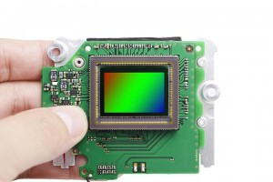
Image Sensors
The two main types of electronic image sensors are the charge-coupled device (CCD) and the active-pixel sensor (CMOS sensor).
Both CCD and CMOS sensors are based on metal–oxide–semiconductor (MOS) technology, with CCDs based on MOS capacitors and CMOS sensors based on MOSFET (MOS field-effect transistor) amplifiers.
Analog sensors for invisible radiation tend to involve vacuum tubes of various kinds.

Slide 61
3D image capture device
3D scanning is the process of analyzing a real-world object or environment to collect data on its shape and possibly its appearance (e.g. colour).
The collected data can then be used to construct digital 3D models. 3D data is useful for a wide variety of applications.
These devices are used extensively by the entertainment industry in the production of movies and video games, including virtual reality.
Other common applications of this technology include augmented reality,motion capture, gesture recognition, robotic mapping, industrial design, orthotics and prosthetics,reverse engineering and prototyping, quality control/inspection and the digitization of cultural artifacts.

Slide 62
3D image capture device
A 3D scanner can be based on many different technologies, each with its own limitations, advantages and costs.
Many limitations in the kind of objects that can be digitised are still present. For example, optical technology may encounter many difficulties with shiny, reflective or transparent objects.
3D scanning technologies can be divided in two main categories: Passive and Active

Slide 63
Types of 3D scanners
Passive scanning: Passive 3D imaging solutions do not emit any kind of radiation themselves, but instead rely on detecting reflected ambient radiation.
Most solutions of this type detect visible light because it is a readily available ambient radiation.
Other types of radiation, such as infrared could also be used. Passive methods can be very cheap, because in most cases they do not need particular hardware but simple digital cameras.
Stereoscopic cameras are the most common passive 3D scanning systems

Slide 64
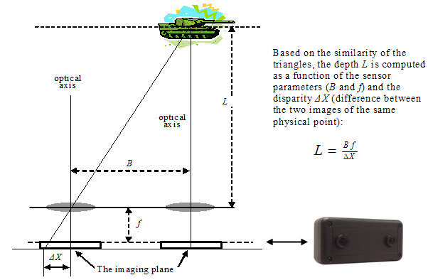
3D passive scanning
Stereoscopic systems usually employ two video cameras, slightly apart, looking at the same scene. By analysing the slight differences between the images seen by each camera, it is possible to determine the distance at each point in the images. This method is based on the same principles driving human stereoscopic vision.

Slide 65
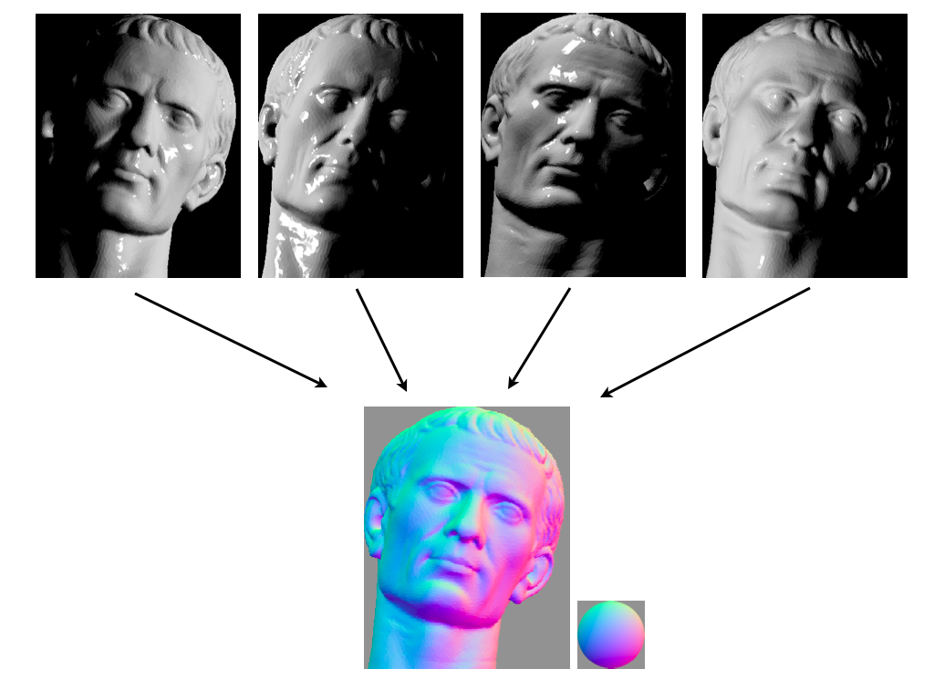
3D passive scanning
Photometric systems usually use a single camera, but take multiple images under varying lighting conditions. These techniques attempt to invert the image formation model in order to recover the surface orientation at each pixel.

Slide 66
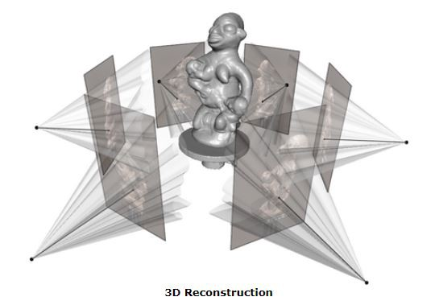
3D passive scanning
Silhouette techniques use outlines created from a sequence of photographs around a three-dimensional object against a well contrasted background. These silhouettes are extruded and intersected to form the visual hull approximation of the object. With these approaches some concavities of an object (like the interior of a bowl) cannot be detected.

Slide 67
3D Active Scanning
Active scanners emit some kind of radiation or light and detect its reflection or radiation passing through object in order to probe an object or environment. Possible types of emissions used include light, ultrasound or x-ray.
Various typologies: Time-of-flight, Triangulation, Structured light, Modulated Light

Slide 68
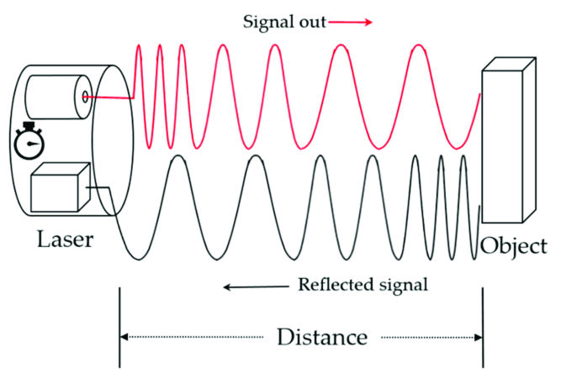
3D Active Scanning
The time-of-flight 3D laser scanner is an active scanner that uses laser light to probe the subject. At the heart of this type of scanner is a time-of-flight laser range finder.
The laser range finder finds the distance of a surface by timing the round-trip time of a pulse of light. A laser is used to emit a pulse of light and the amount of time before the reflected light is seen by a detector is measured. 3.3 picoseconds (approx.) is the time taken for light to travel 1 millimetre.
The laser range finder only detects the distance of one point in its direction of view. Thus, the scanner scans its entire field of view one point at a time by changing the range finder's direction

Slide 69
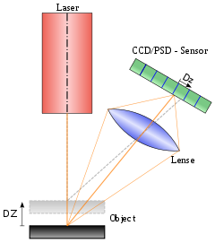
3D Active Scanning
Triangulation based 3D laser scanners are also active scanners that use laser light to probe the environment. With respect to time-of-flight 3D laser scanner the triangulation laser shines a laser on the subject and exploits a camera to look for the location of the laser dot.
Depending on how far away the laser strikes a surface, the laser dot appears at different places in the camera's field of view.
This technique is called triangulation because the laser dot, the camera and the laser emitter form a triangle.

Slide 70
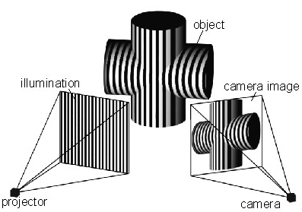
3D Active Scanning
Structured-light 3D scanners project a pattern of light on the subject and look at the deformation of the pattern on the subject. The pattern is projected onto the subject using either an LCD projector or other stable light source.
A camera, offset slightly from the pattern projector, looks at the shape of the pattern and calculates the distance of every point in the field of view.
The advantage of structured-light 3D scanners is speed and precision. Instead of scanning one point at a time, structured light scanners scan multiple points or the entire field of view at once.
Scanning an entire field of view in a fraction of a second reduces or eliminates the problem of distortion from motion.

Slide 71
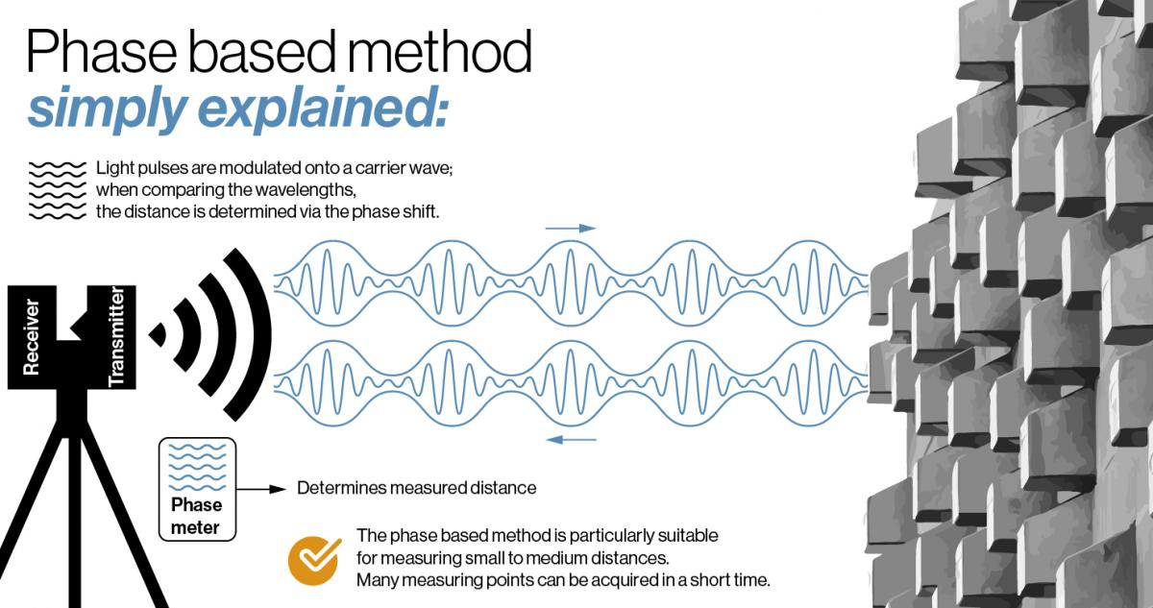
3D Active Scanning
Modulated light 3D scanners shine a continually changing light at the subject. Usually the light source simply cycles its amplitude in a sinusoidal pattern. A camera detects the reflected light and the amount the pattern is shifted by determines the distance the light travelled. Modulated light also allows the scanner to ignore light from sources other than a laser, so there is no interference.

Slide 72
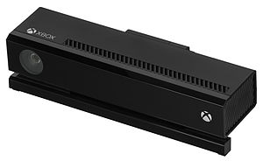
Microsoft Kinect
Kinect is a line of motion sensing input devices produced by Microsoft and first released in 2010.
The technology includes a set of hardware originally developed by PrimeSense, incorporating RGB cameras, infrared projectors (active - structured light) and detectors that mapped depth through either structured light or time of flight calculations, and a microphone array, along with software and artificial intelligence from Microsoft to allow the device to perform real-time gesture recognition, speech recognition and body skeletal detection for up to four people, among other capabilities.
This enables Kinect to be used as a hands-free natural user interface device to interact with a computer system.
Product discontinued→ alternatives

Slide 73
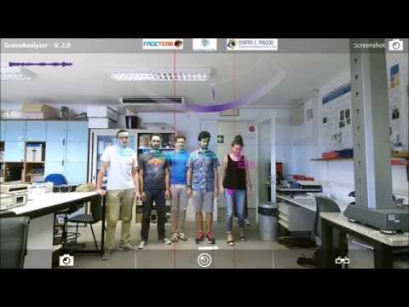

Slide 74
Novel UI are blended!

Slide 75
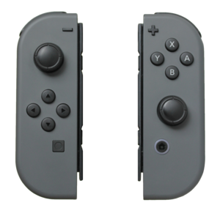
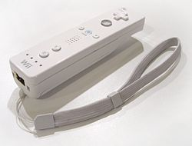
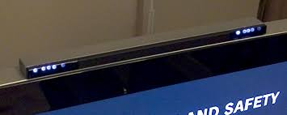
Wii Remote and similar Motion Sensing devices
The Wii Remote, is the primary game controller for Nintendo's Wii home video game console.
An essential capability of the Wii Remote is its motion sensing capability, which allows the user to interact with and manipulate items on screen via gesture recognition and pointing, using IMU and optical sensor technology.
The Wii Remote was eventually succeeded by the more advanced Joy-Con controllers of the Nintendo Switch.

Slide 76
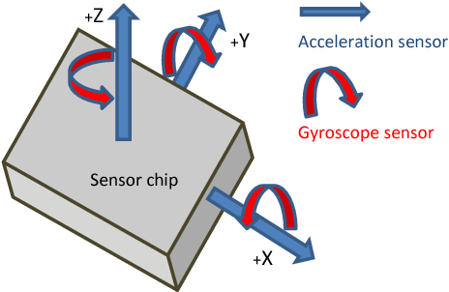
IMU Inertial Measurement Unit
An inertial measurement unit (IMU) is an electronic device that measures and reports a body's specific force, angular rate, and sometimes the orientation of the body, using a combination of accelerometers, gyroscopes, and sometimes magnetometers.
9-Axis devices combine a 3-axis gyroscope, 3-axis accelerometer and 3-axis compass (magnetometer) in the same chip together with an onboard Digital Motion Processor capable of processing the complex MotionFusion algorithms

Slide 77
Hacking the user interface and experience
https://www.youtube.com/watch?v=6YIAR4WZmes&ab_channel=DanieleMazzei
https://www.youtube.com/watch?v=6F7MzmySx9g&ab_channel=DanieleMazzei
https://www.youtube.com/watch?v=oQ2VCi-6uGI&ab_channel=DanieleMazzei

Slide 78
Wearable Devices and User Interfaces
A wearable computer is a computing device worn on the body. The interface and the computing unit are merged together!
Wearables may be for general use, in which case they are just a particularly small example of mobile computing. Alternatively they may be for specialized purposes such as fitness trackers.
They may incorporate special sensors such as accelerometers, thermometer and heart rate monitors, or novel user interfaces such as Google Glass, an optical head-mounted display controlled by gestures.
It may be that specialized wearables will evolve into general all-in-one devices, as happened with the convergence of PDAs and mobile phones into smartphones.

Slide 79
Wearable Devices and User Interfaces
Wearables are typically worn on the wrist (e.g. fitness trackers), hung from the neck (like a necklace), strapped to the arm or leg (smartphones when exercising), or on the head (as glasses or a helmet), though some have been located elsewhere (e.g. on a finger or in a shoe).
Devices carried in a pocket or bag – such as smartphones and before them pocket calculators and PDAs, may or may not be regarded as 'worn'.
Wearable computers have various technical issues common to other mobile computing, such as batteries, heat dissipation, software architectures, wireless and personal area networks, and data management.
Many wearable computers are active all the time, e.g. processing or recording data continuously.

Slide 80
Heart Rate Wearable Monitor
A heart rate monitor (HRM) is a personal monitoring device that allows one to measure/display heart rate in real time or record the heart rate for later study.
Consumer heart rate monitors are designed for everyday use and do not use wires to connect and are (typically) not suitable for medical applications
they commonly use electrical and/or optical measurement principles. Both types of signals can provide the same basic heart rate data, using fully automated algorithms to measure heart rate.
ECG (Electrocardiography) sensors measure the bio-potential generated by electrical signals that control the expansion and contraction of heart. VIDEO
PPG (Photoplethysmography) sensors use a light-based technology to measure the blood volume controlled by the heart's pumping action. some devices using this technology are able to measure aslo blood oxygen saturation (SpO2). more info

Slide 81
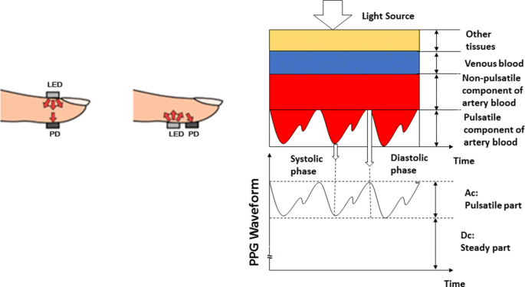
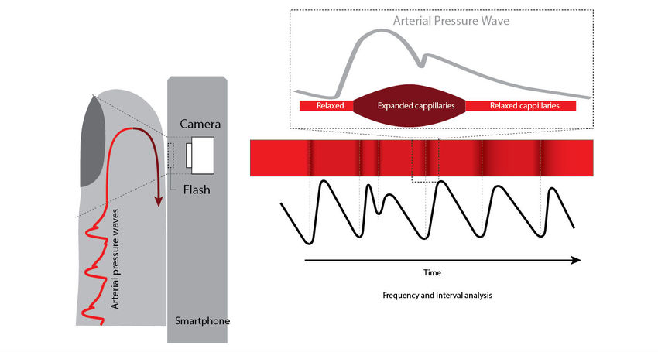
PPG (Photoplethysmography)

Slide 82
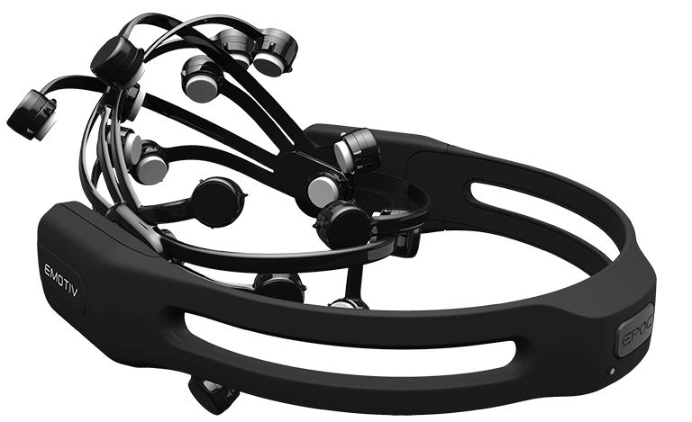
EEG Headset
Electroencephalography (EEG) is a monitoring method to record the electrical activity of the brain.
Wearable EEG headsets position noninvasive electrodes along the scalp. The clinical definition of EEG is the recording of brain activity over a period of time. EEG electrodes pick up on and record the electrical activity in your brain.
The collected signals are amplified and digitized then sent to a computer or mobile device for storage and data processing.
EEG Headset are used as pointing devices for dibale and impaired subjects
https://www.youtube.com/watch?v=LZrat-VG4Ms&ab_channel=GSMArenaOfficial

